Slide 1
Angular introduction training
Get some basics about developing in angular 2+ version
Trainer : Straka Lukáš
Email: lukas.straka@t-systems.com

Slide 2
What is angular ?
Web-framework
Single page architecture
Built in typescript + HTML
Rebuild into JS (ES5, ES6)
Allow to build mobile and desktop (additional lib)
Current stable version is 10.2 in cmd ng --version
Ng CLI – big advantage for beginners
https://angular.io/

Slide 3
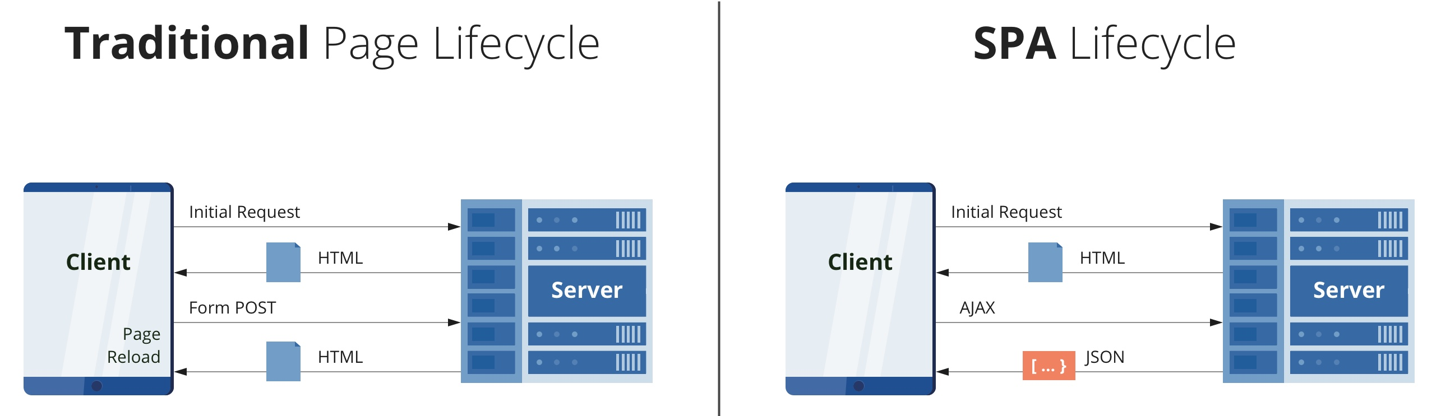
SPA vs. Traditional
https://dzone.com/articles/the-comparison-of-single-page-and-multi-page-appli

Slide 4
ng-cli
Initialization of angular project
ng new {projectName}
Run angular application
ng serve
Build application (also prod)
ng build --prod
Generate any type of component
ng generate component|service|module …

Slide 5
Project structure
node-modules – all libraries are stored there which we can used in project
Index.html - single html file where all other templates are rendered
angular.json – provides project specific configuration
package.json – required libraries, scripts, info
main.ts – main file which bootstrapping application module (main class)

Slide 6
G2K (good to know) - package.json
managing the project’s dependencies, scripts and version
npm install {dependency} -save
-save :save installed lib to package.json
Dependency versions – symbol is important!
~ (tilde) – allow to update patch version ~1.2.3 > max 1.2.x
^ (caret) – allow to update minor version ^1.2.3 > max 1.X.X
version without (~/^) means v1.2.3 will always stay as v1.2.3
update major version 1.2.3 need to run npm update {lib}

Slide 7
What is necessary to run angular application ?
Prerequisite (installed node js/npm)
From existing project we need src folder, angular.json, package.json and all tsconfig* files
DON`T upload/share node-modules folder with project, it will be installed automatically by running npm install from the root of project

Slide 8
Component
The most basic building block of angular app
decorator @Component
Angular application is represented as tree structure of components
Usage of component is via the selector <app-XX> in parent template (component also)
Selector and template are mandatory for each component
Component is type of controller for a view it contains metadata which are transferred to the view

Slide 9
Component
Template representation :
inline template ( means in .ts file we define view (html code)
or use separate .html file (also known as view)
Stylesheet is represented same way as template
part of .ts file - inline style
extra file .css
Stylesheet is not required as part of component
Each component use style.css which is located in src folder in the root of app
@Component({
selector: 'app-root',
templateUrl: './app.component.html',
styleUrls: ['./app.component.css']
})
@Component({
selector: 'app-root',
template: `<h1> This is inline template </h1>`,
styleUrls: ['./app.component.css']
})

Slide 10
Ng-Module
Angular app are modular
At least one module in the application
It is file where we have to declare everything what we want to use in application.
Each component which we want to use has to be declared in module
Each service which we wanna use has to be provided in module in providers object

Slide 11
Ng-Module
Decorator @NgModule
If we want to import something and use it under out module, we have to Import it
It is also possible to allow usage of something from our module, then we have to export it

Slide 12
NgModule
@NgModule({
declarations: [AppComponent],
imports: [BrowserModule],
providers: [],
bootstrap: [AppComponent],
exports: []
})

Slide 13
DataTypes in Angular
number – const iAmNumber : number = 0;
string – const iAmText: string = ‘I am text’;
boolean – const isTrue: boolean = false;
Date – const now: Date = new Date();
Array [] – string[], number[], object[] etc.
Object – defined by Class or Interface
any – wildcard, when we do not know correct return type of something

Slide 14
Class / interface
type of model (etc. User)
generated via ng-cli
have no decorator
defined as exported object with type Interface or class
can be as standalone file or part of component`s file if
export interface|class <name> {
properties...
}

Slide 15
Interpolation
allow to add component fields directly to template
interpolation in html file by {{ nameofproperty }}
<p>{{ title }} </p>

Slide 16
Day 1 ends

Slide 17
Access modifiers
public – available everywhere
private – only inside component/class
protected – available in extended class
default is always public
private fields or methods should start with _ .
private _foo private_foo()
fun fact is that typescript lint, thinks its bad naming convention

Slide 18
get / set
used when using private/protected values and maybe you do not want to support writing only reading the field
private _age: number;
public get age(): number {
return this._age;
}
public set age(age) {
this._age = age;
}

Slide 19
Data binding
one way data binding
from .ts to html – interpolation {{property}}
from html to ts – using event in html, property changed state
two way data binding
using ngModel – used in forms in html file
you have to import FormsModule in corresponding module where you want to use ngModel

Slide 20
ActionEvents
click – (click)
doubleclick (dblClick)
blur (blur) – on lost focus
focus (focus) when element got focused
action events are used when you need to transfer/call some metadata from view to controller

Slide 21
Methods
There are 2 types of methods
with return type- foo(): any
void methods without returning – foo(): void
It is recommended to use private modifier for all methods by default, but it`s again just practice
Method with returned type can be bind to the html view via {{interpolation}}
be sure that this method not contain any long-running operation in the body, you can place console.log() inside that method and interpolate it for understanding ☺

Slide 22
Directives
In angular are used to manipulate with DOM
3 main types of directives used in angular
component – always have own template (html) defined by selector as html tag with own logic
structural directive – change DOM layout
attribute directive – change behavior of element in DOM

Slide 23
Directives - structural
When applying this type of directive it means that you add or remove something from the DOM
to recognize that you are using built-in structural directive you will see * sign before name of directive
there are 3 built-in structural directives :
*ngIf
*ngFor
*ngSwitchCase

Slide 24
Directives - attribute
change behavior over the html element with the condition
built in attribute directives should be ngClass or ngStyle
One the most used attribute directive is [hidden]
You are able to create your own custom directive which will change something over the DOM

Slide 25
Custom directive
You can create both structural or attribute custom directive
directive should be generated via ng-cli
Directive is marked with decorator @Directive
we can try custom directive by the tutorial in angular official
https://angular.io/guide/attribute-directives
https://angular.io/guide/structural-directives

Slide 26
Pipes
used to provide some formatting action over the template literal
pipe can be used only over the data from component inside curly bracets {{}}
there are several built-in pipes like Date, uppercase etc.
it is possible to create own pipe over the property

Slide 27
Lifecycle hooks
There are several events which are called during the life of each component. I think the main which you should use at the beginning are :
ngOnInit
ngAfterViewInit
ngOnChange
ngOnDestroy

Slide 28
Communication between components
There are different types of communication or passing data between components related to position of component
Parent to child
child to parent
siblings

Slide 29
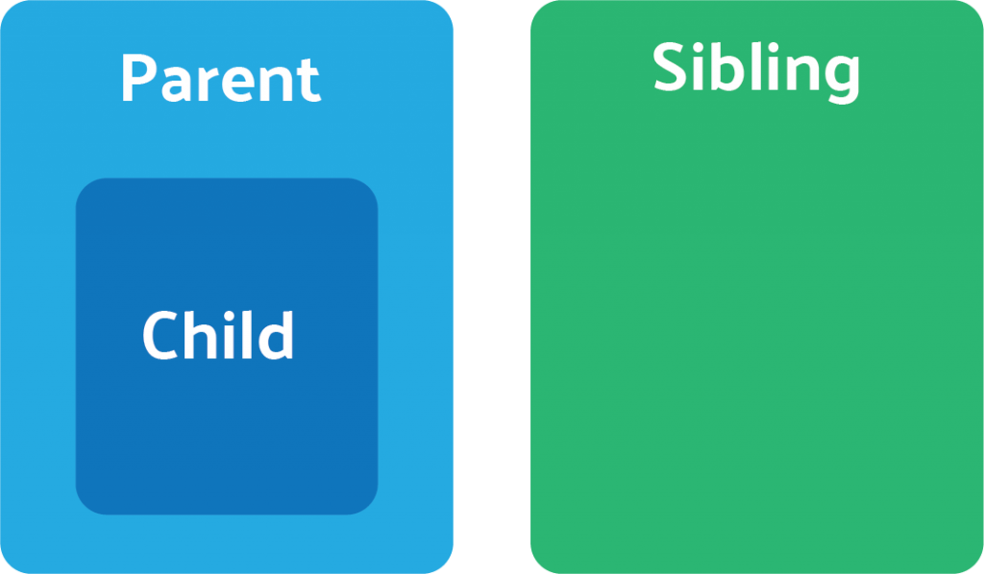
Communication between components

Slide 30
Parent => child
It is possible to pass data to child or call method in child component which are public
@Input
@ViewChild (child reference)
@ViewChildren(QueryList of child references)

Slide 31
Child => parent
It allow us only pass value from child to parent using Output
Output is type of EventEmmiter and in child you decide when you want to emit changes to parent

Slide 32
Component to component
provided by service and Subject object
Subject is part of rxjs library
Subject – on init always null, and subscribe not work
BehaviorSubject – on init has previous value, or initial default value which is defined in service

Slide 33
ng-template
is hidden part of structural directives with *
without usage of [ngIf] condtition everything what is inside that is not visible in the DOM
allow us provide if-else in html or also if then else
standalone it is not possible to use that, because nothing what is inside the template is not shown

Slide 34
ng-content
provide option for dynamic content inside the child component from parent component
also known as a content projection
it is possible to have multiple contents in child

Slide 35
ng-container
something like invisible html tag
mainly used with *ngFor directive
its not possible to set style or anything to that html tag

Slide 36
Services - REST
way how to communicate with backend
usually there are several operations which are done from client and have to be transferred to the backend
by default it is recommended to use AJAX calls,it means asynchronous, do not wait till call ends

Slide 37
Services - REST
Services communication via HTTP protocol and use methods:
GET
POST
PUT
DELETE

Slide 38
Services - Observable
To communicate with the server in angular it is recommended to use Observable
It`s not required, but it is the simplest way how to providing REST api calls
Each response type is by default awaiting json type of response
it is possible to change the content/type by the options in request method.

Slide 39
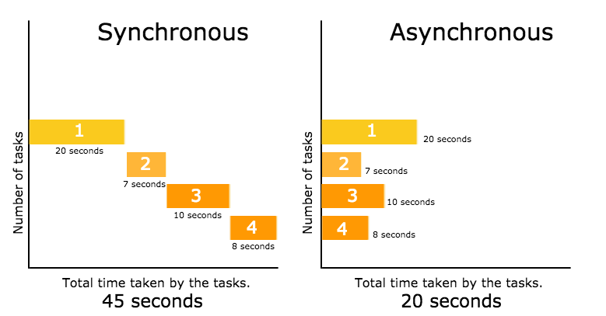
Sync vs Async

Slide 40
End of presentation
Thank you for participate
Lukas Straka

